Slide 1

Modern App Development In-Depth:
Building a Modern Web Application
Allen Conway
Lead Consultant,
Magenic
Level: Intermediate

Slide 2

Intro
Allen Conway
Blog: http://www.AllenConway.net
Twitter: @AllenConway, http://www.twitter.com/AllenConway
GitHub: https://github.com/AllenConway
Email: AllenC@Magenic.com

Slide 3
What we will cover
MyVote Application
Modern Web Applications Overview
VS.NET SPA Templates
Azure Websites
Azure Mobile Services
JavaScript Primer
Building an AngularJS app with TypeScript
Responsive Web Design
Real-Time Messaging with SignalR

Slide 4

The MyVote Technology Stack
HTML5/CSS3 Responsive Design
AngularJS + TypeScript
Azure Web Sites and Azure Mobile Services
ASP.NET Web Pages (not MVC!)
ASP.NET Web API
CSLA
Azure SQL Server

Slide 5
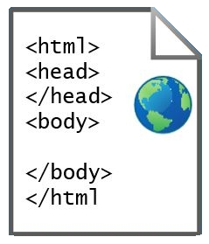

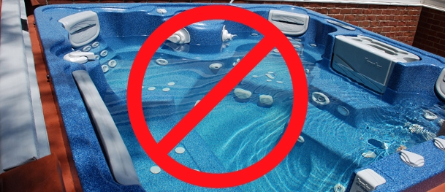
What exactly is a SPA??
Single Page Application
What’s with the ‘Single Page’ – Do I have to do everything in 1 page?
HTML web page “shell” is sent once to the browser

Slide 6
Cross Browser, Platform, Device
JavaScript Applications + Responsive design
Browser and device agnostic
Best on browsers supporting HTML5 and CSS3
http://caniuse.com/
More accepted on mobile devices
JavaScript will rule the world!!
Should I go to the web?
Native per platform
Xamarin
Hybrid/PhoneGap
http://magenic.com/Resources/ID/2

Slide 7
How are JavaScript Applications different from ASP.NET MVC or Webforms?
Shift in application logic from the server to the client
UI and application logic is now done in the browser
How HTML is delivered
ASP.NET web apps merge data with HTML before delivering to the client
Server’s main responsibility: Data
JavaScript MV* Frameworks

Slide 8
Where did we come from?
Static DOM
Static DOM
Static DOM
Static/Dynamic
DOM
Code-Behind
Controller
Controller
Services / Data

Slide 9
The Modern Web: Single Page Applications
Master Layout
Model
View
(Dynamic DOM)
Controller
Services
Renderer
Services / Data

Slide 10


SPAs in the Enterprise
Well-known JavaScript Applications
Weather.com, Walgreens, MSNBC
Making that accounting, shipment tracking, inventory, etc. application as a SPA
Considerations before making that next application a modern web application

Slide 11

Why JavaScript Web Applications are… AWESOME
Lean, mean, fighting machines!
Fluid and responsive
Narrowing the line between desktop and web from UX perspective
Mature browsers
HTML5
CSS3
JS Processing
JavaScript Frameworks follow familiar patterns

Slide 12

Disadvantages and Challenges of JS Web Applications
Frameworks are volatile
Take notice: JavaScript is required
Sea of JS frameworks for creating modern web apps
Years of working almost exclusively in managed code on the server (C#/VB.NET)
Mindset of doing so much on the client
Difference in the way of thinking about web design

Slide 13
Building a modern web app from the ground up
VS.NET 2013/5 technically have a SPA template
Biggest Swiss army knife you’ve ever seen
Begin with an empty ASP.NET application
Pull in only what is needed
Start with JS Framework, Bootstrap, Modernizr, Typescript definitions
If unsure of where to start, work backwards cleaning house in SPA template
Strip out what isn’t needed
https://github.com/AllenConway/JSAppBasicTemplate

Slide 14
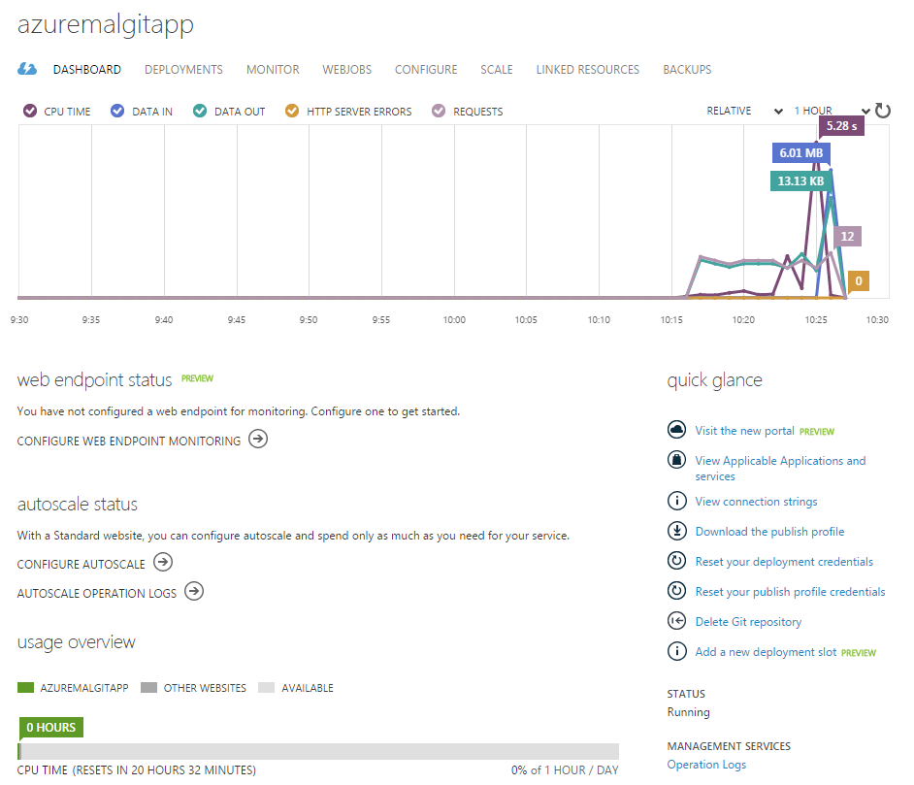

Azure Websites
Host your own web applications
Multiple hosting options
Multiple Source Control Integration Options
Azure Management Portal
Easy to use – no IIS or server to manage

Slide 15

Azure Mobile Services
Platform parity
Facilitate a shared experience
Identity
Data/Sync
Notifications
Backend jobs
Push Notification support
Fastest way to get up and running

Slide 16
Secure Token Service
Login Info
STS Provider
Token
Facebook
Custom Application

Slide 17
Azure Mobile Services Security
Authentication
Leverage multiple mainstream identity providers
Authorization
Hand roll in app
Table permissions on Azure
Use scripts in Azure
Leverage HTML5 Local Storage
Store JWT from AMS
https://github.com/Magenic/JWTvalidator
[DEMO]

Slide 18

JavaScript and the Modern Web
Let’s not sugar coat it – we need JS
Object.prototype.__proto__
Follow mainstream JS patterns
Modules (Module & Revealing Module Patterns)
Closures
Promises
Leverage JS frameworks and Libraries
AngularJS
Aurelia/Durandal
ReactJS
Ember
Backbone

Slide 19
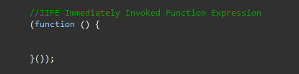
Avoiding JavaScript Goo
Understand the global/public nature of JS
Prevent stepping on our own toes
Avoid polluting the global namespace
Window object
Issues in global namespace
Name collisions and unexpected behavior
IIFE - "Immediately-Invoked Function Expression“
Used widely in Angular to define modules

Slide 20

TypeScript
Type-safe, statically-verified JavaScript
IntelliSense!
Familiar paradigms
Leverage your C# classes
TypeScript with AngularJS
Module = app
Class = controller, service, etc.
TypeLITE
Generates TypeScript definitions from .NET classes

Slide 21

TypeScript Advantages
Low barrier of entry
Keep those JS skills!
…and flexibility of a dynamic language if needed
Can adopt completely on the server
tsc.exe
Break down the barriers of having ‘MyApp.js’
Scripting language vs. OO style language
Open source from day 1
Maintained by Microsoft, Apache License
#failfast

Slide 22

TypeScript to JavaScript Language Comparison
Compile time type safety checking
More concise syntax
Syntactical Sugar makes getting from A -> B easier
Familiar keywords
Scope is easier to follow
[DEMO]

Slide 23
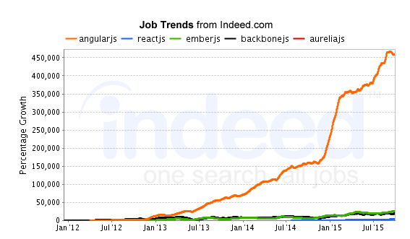
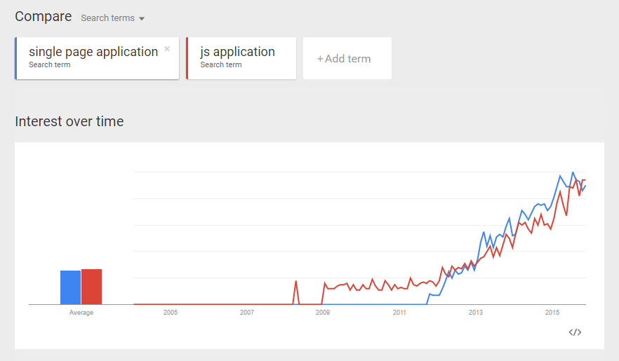
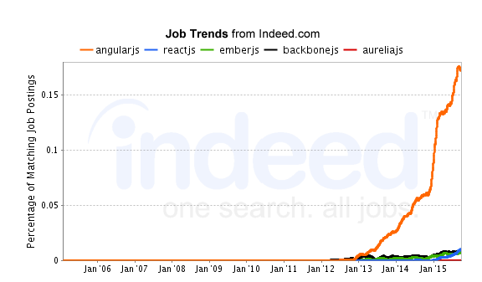
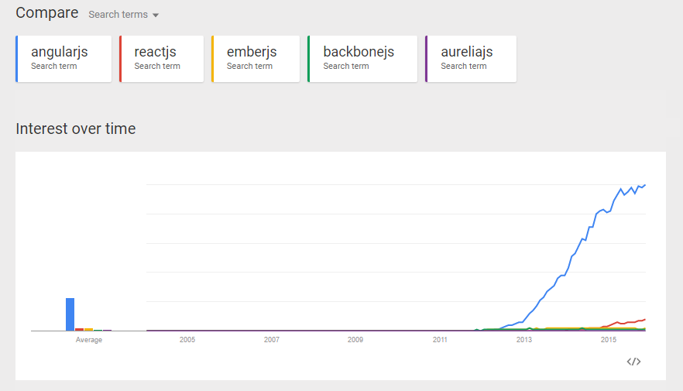
JavaScript Framework Popularity

Slide 24

AngularJS
Complete client side MVW framework for creating SPAs
Compliments the server
Originally started at Google, now OSS
Declarative style of programming
Manipulating the DOM
Imperative style of programming
Expressing logic
Easy to use and learn

Slide 25
AngularJS – Directives
Directives are intermediary to provide SoC
ng-* nomenclature defines an Angular directive
Markers on a DOM element
Do not operate on the global namespace
Everything inside of the ng-app directive will be controlled by Angular

Slide 26
AngularJS – Templates/Views
HTML Template
Angular directives,
Databinding {{}},
Controls
Template is combined with information from the model and controller to render view
Main template will contain overall layout
HTML, CSS, and Angular directives
“Partial” views loaded from ng-view

Slide 27
AngularJS – Controllers
Class-like Objects that drive Model and View changes
JS function used to augment the Angular Scope
Provides the application behavior that supports the declarative markup in the template
ng-controller directive
Use an IIFE to prevent pollution
$routeprovider to specify a controller for a template

Slide 28
AngularJS – Models
Encapsulate data and behavior
Model does not touch HTML
Data binding moves model data to the view
Directives provide indirect model view interaction
Leverage caching to prevent multiple roundtrips
Helps keep data out of the root $scope

Slide 29
AngularJS – Services
Allows encapsulating functionality related to a specific function
Angular provides several built in services ($http, $location, $log, etc.)
Services are singletons instantiated once per app
Provide reusable functionality
Services leverage DI via constructor injection

Slide 30
AngularJS – Putting it Together
User will request a page in your application
Server will deliver main page containing the template (i.e. index.html)
Angular loads into the page and waits for it to be fully loaded and looks for ng-app directive to define the template boundaries
The template is then traversed by Angular looking for directives and bindings
The DOM is manipulated via registration of listeners and getting initial data from the server
The app is bootstrapped and the template is converted into a view
Good idea to use ng-bind on your 1st page as opposed to {{}} so users don’t see an unrendered view

Slide 31
AngularJS playground - Plunker
Plunker (plnkr.co)
Integrated web development environment completely written in AngularJS (proof is in the pudding already!)
Create ‘plunks’ and share with others
Pull in Angular and needed libraries easily
Ability to test and review chunks of Angular, JS, CSS quickly and easily
[DEMO]

Slide 32

Responsive Design
Further elevate your code :: eyeball ratio
Foot in the door for mobile devices
Invest in your base template
Core technique: CSS Media Queries (CSS3)
Tools for testing
[DEMO]

Slide 33
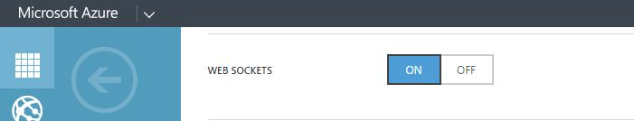
SignalR
Real-time push communication
Notifications, streaming, etc.
Azure Web Sites supports Web Sockets
Leverages existing application’s authentication mechanism
[DEMO]

Slide 34

SPA Performance
The big payoff – fast, fast, fast and don’t forget… efficient!
Save CPU usage on the server
Save network bandwidth
Use ‘Network’ tab in debugging tools
Request count
Size
Time
Techniques
Caching
Bundling / Minification
Application Insights

Slide 35
Useful References
MyVote on GitHub
https://github.com/Magenic/MyVote
Plunker
http://plnkr.co/
AngularJS API Docs
https://docs.angularjs.org/api
AngularJS Training
http://egghead.io/
http://thinkster.io/
http://www.pluralsight.com/
Bootstrap
http://getbootstrap.com/
Azure Mobile Services
http://azure.microsoft.com/en-us/documentation/services/mobile-services/

Slide 36

Questions
Thank you for attending Modern Apps LIVE!

